Slide 1
Simulation Of an organic memristor
By: Cem Bonfil

Slide 2
Overview
What is a memristor ?
Organic Memristor Modelling
Application of Finite Difference
1-D and 2-D Memristor Simulations
2-D Simulation vs. Experimental Results
Conclusion

Slide 3
1-What is a memristor ?
Voltage controlled resistor with memory
Equation: M(q(t)) = V(t)/I(t)
2 Distinct types
Organic: Based on PEDOT:PSS….
Inorganic: Based on TiO2

Slide 4
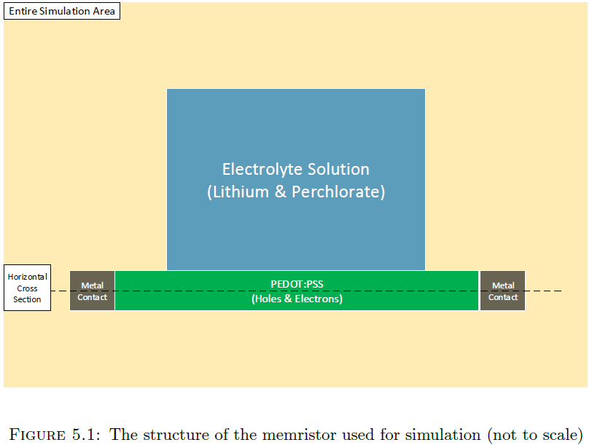
2. Organic Memristor Modelling

Slide 5



2.1- General Equations
Drift diffusion equation:
Continuity Equation:
Poissons Equation:

Slide 6
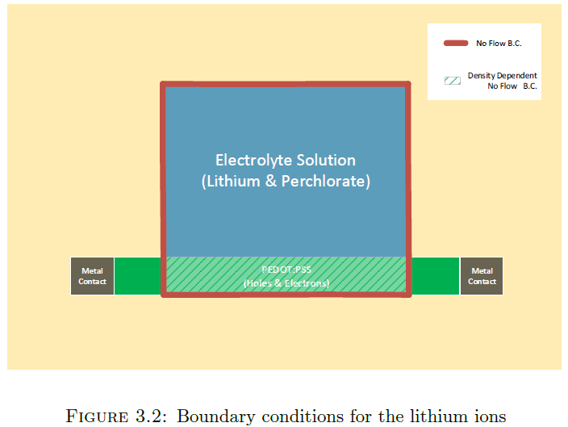
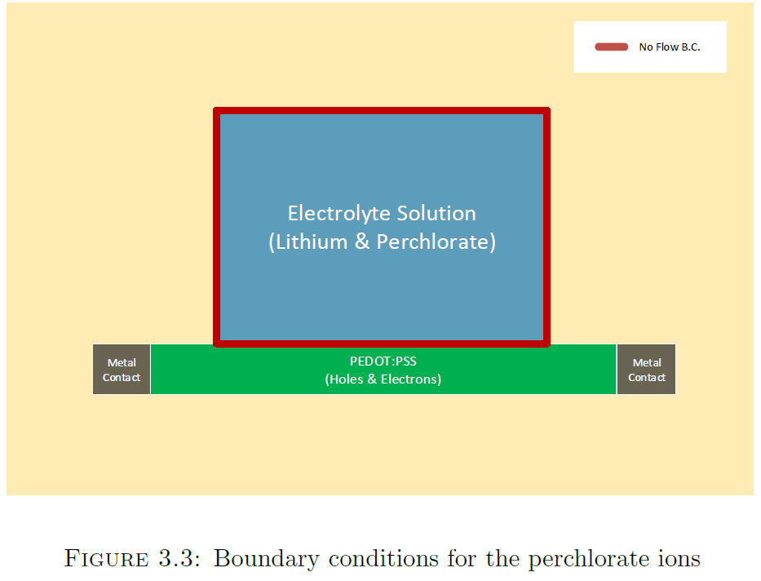
2.2 BoundarY conditions

Slide 7
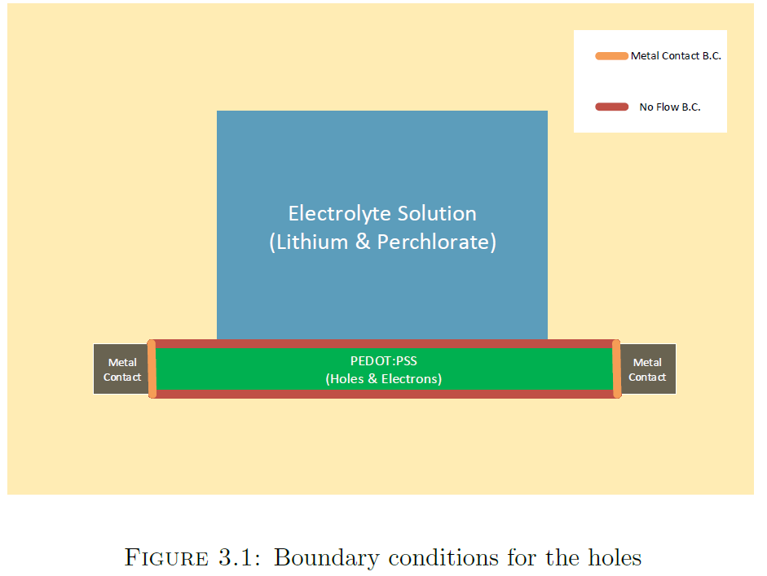
2.2 BoundarY conditions
Notes:
Add E,V Boundary conditions

Slide 8
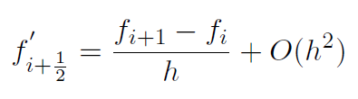


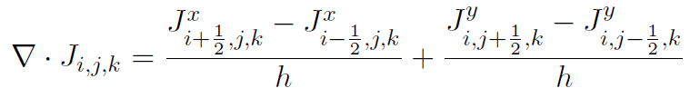

3. Application of Finite Difference
First Order Central Difference :
Second Order Central Difference:
Current Density
Continuity
Poisson’s Equation

Slide 9
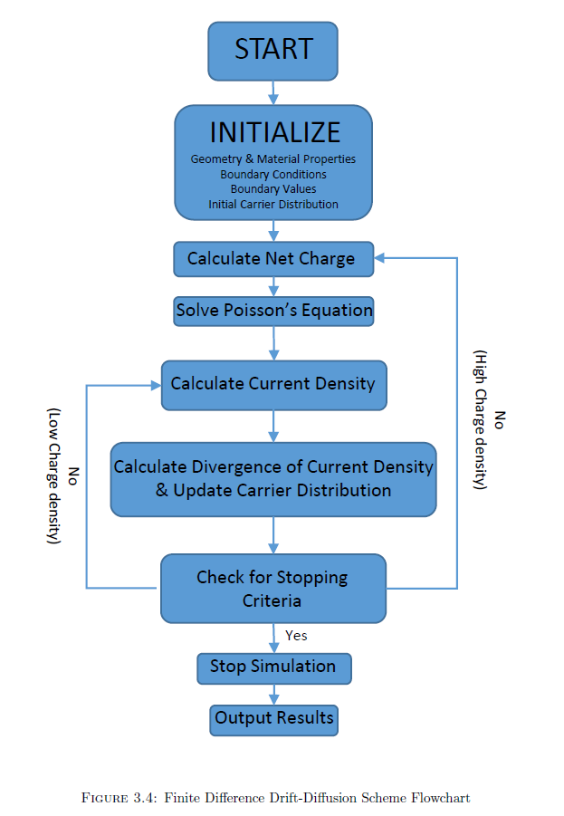
3.1- Solution Process

Slide 10
3.2 Current Limiting Mechanism

Slide 11
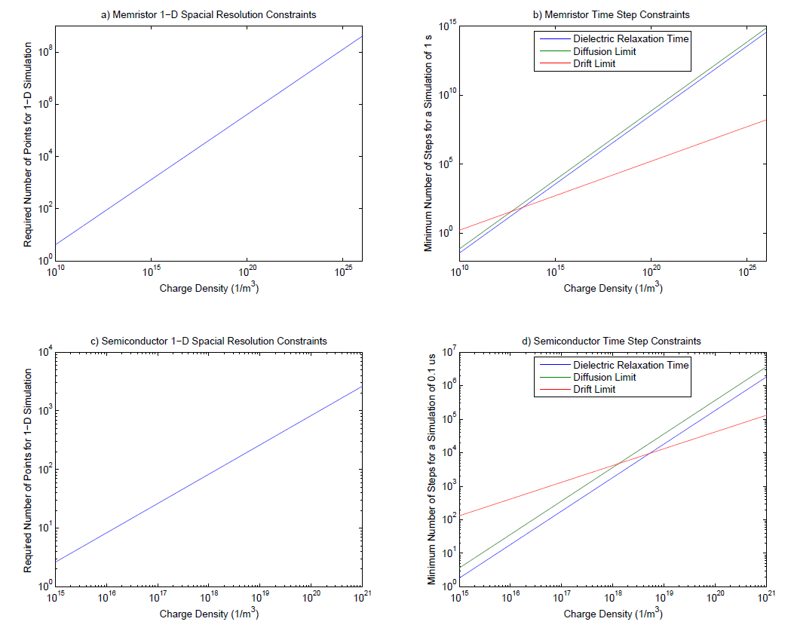
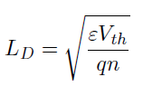



3.3- Numerical and Physical Limitations
Debye Length:
Dielectric Relaxation Time
CFL Conditions
Drift
Diffusion:

Slide 12
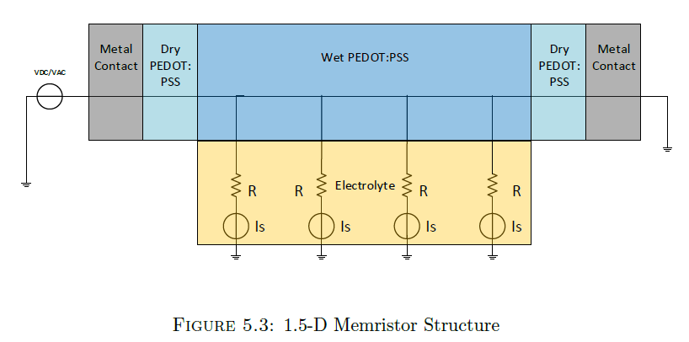
4- 1-D and 2-d memristor Simulations

Slide 13
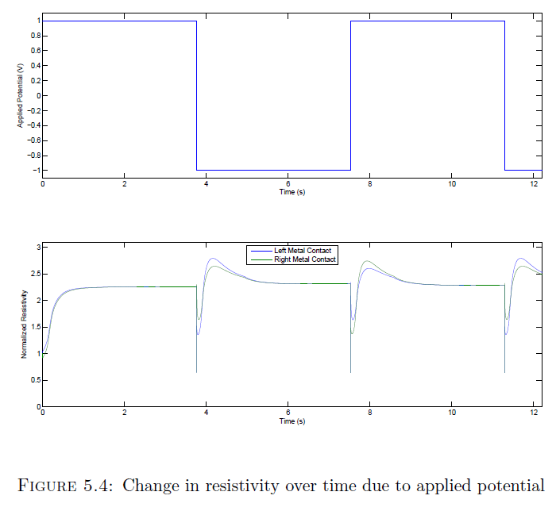
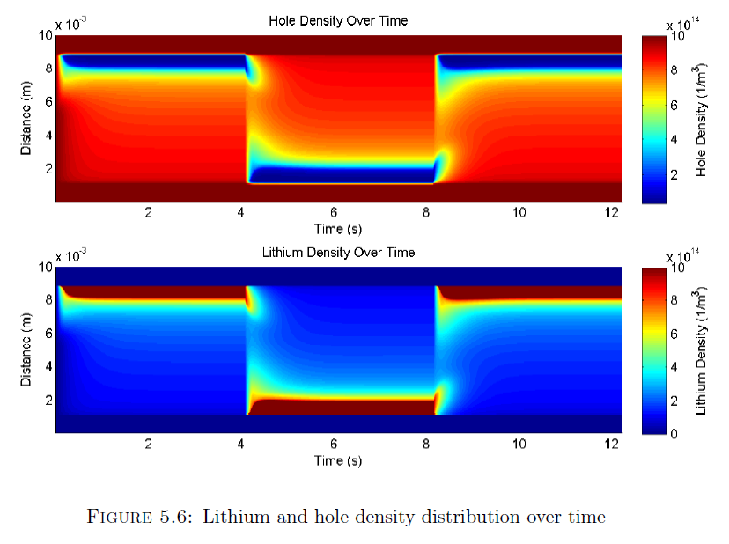
4.1 – 1-D Memristor Simulation
Notes:
Potential pulse train: Current Output, Lithium, hole density, Efield ?

Slide 14
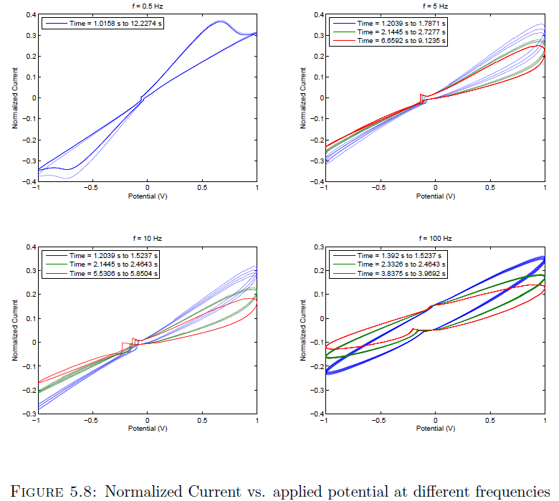
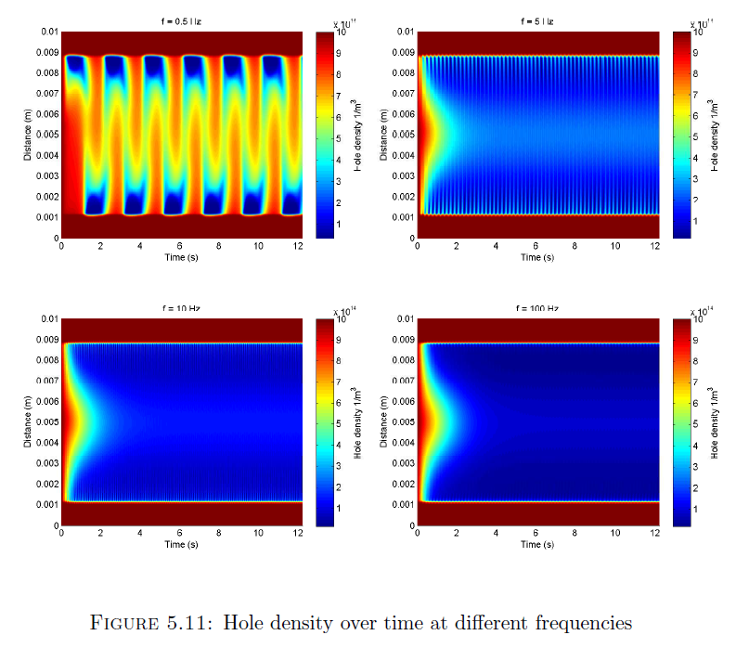
4.1 – 1-D Memristor Simulation cont.
Notes:
Sinusoid: Current Output, Lithium, perchlorate and hole density, Efield ?

Slide 15
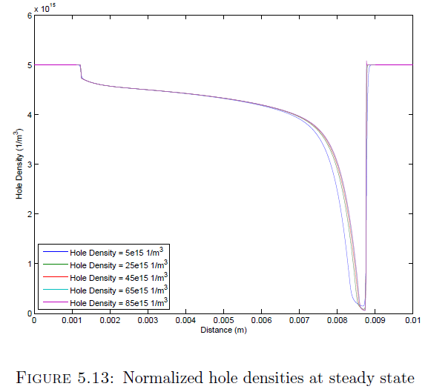
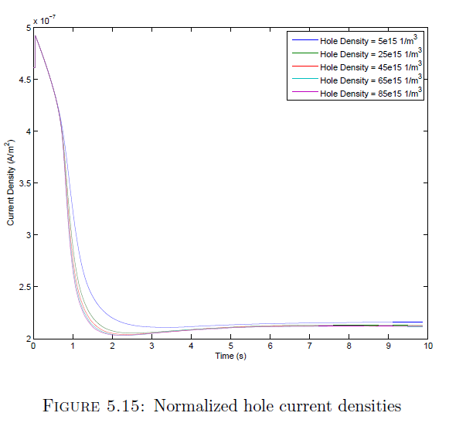
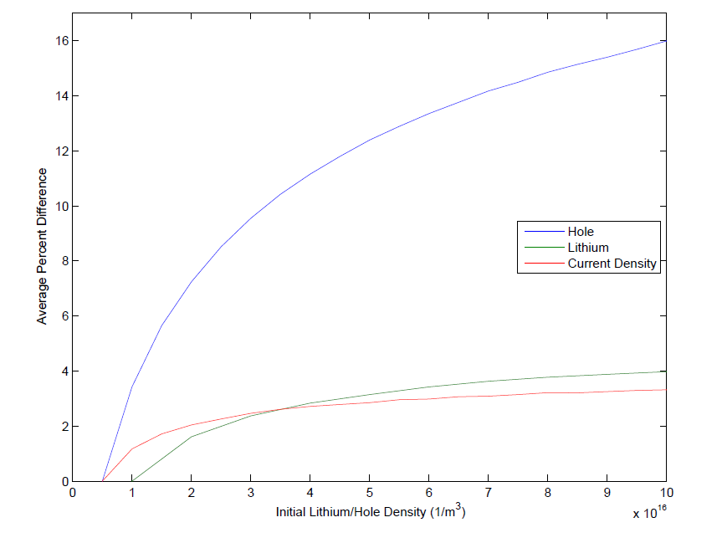
4.2- Scaling to Higher densities

Slide 16
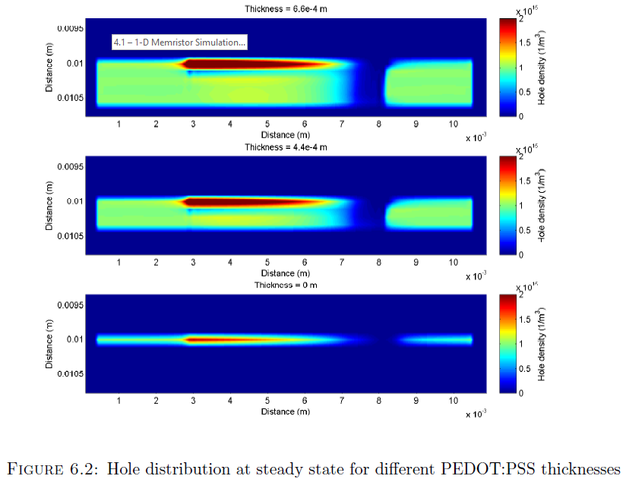
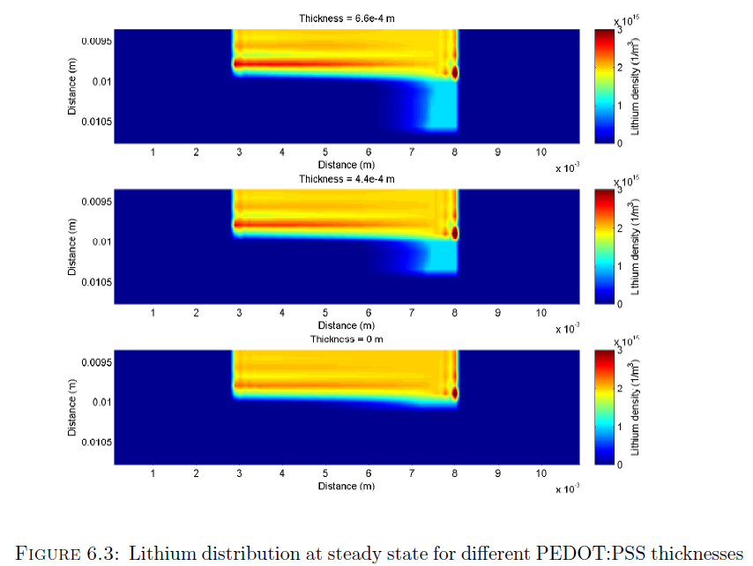
4.3- 2-D Memristor Simulations

Slide 17
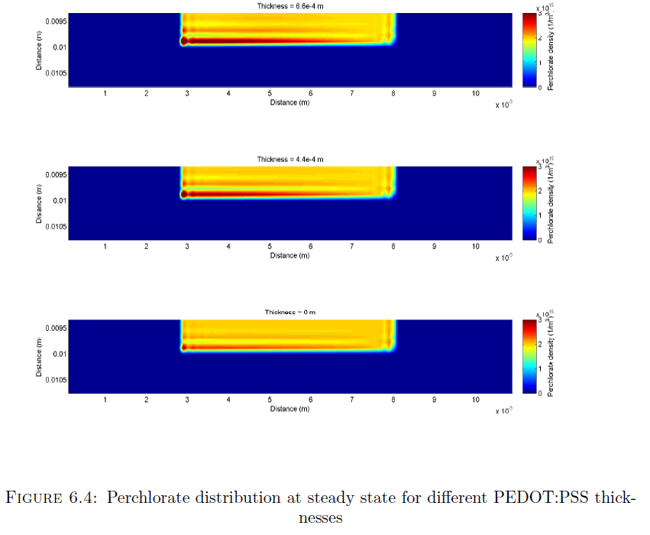
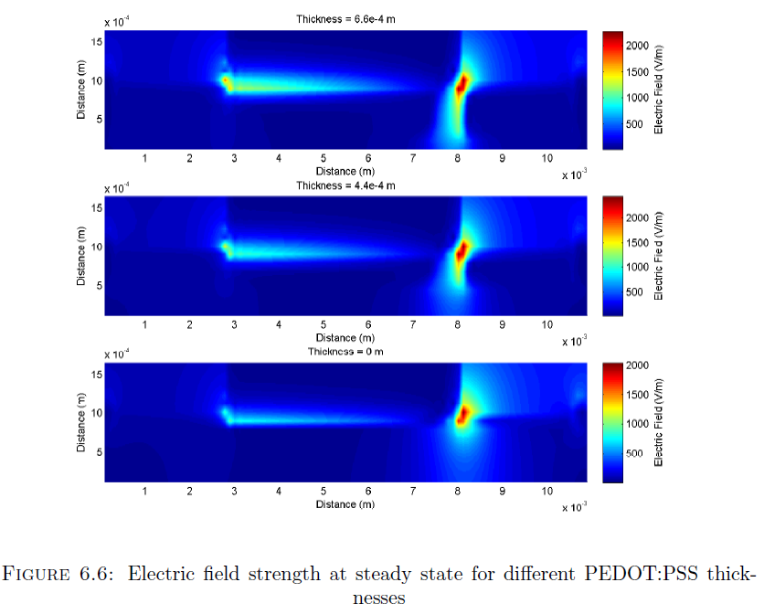
4.3- 2-D Memristor Simulations

Slide 18
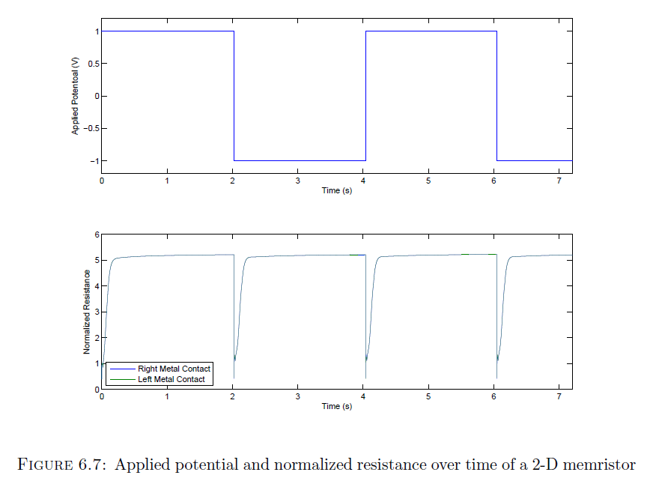
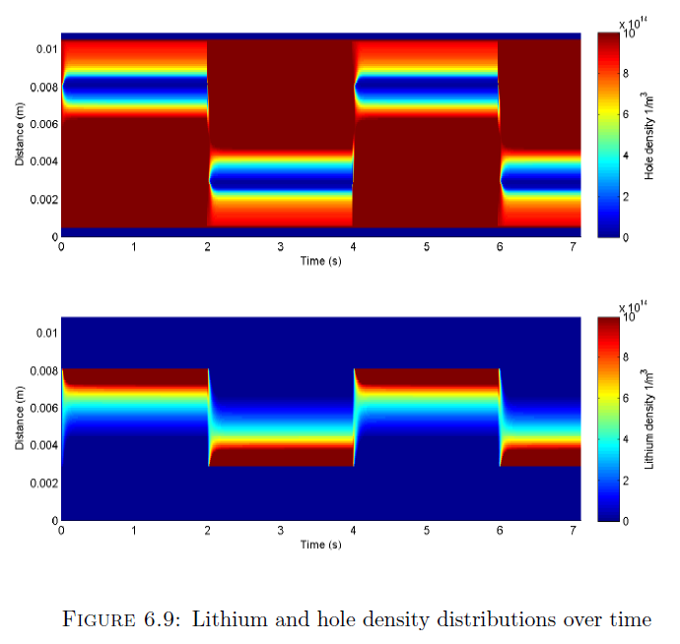
4.3- 2-D Memristor Simulations
Notes:
Potential pulse train: Current Output, Lithium, perchlorate and hole density, Efield ?

Slide 19
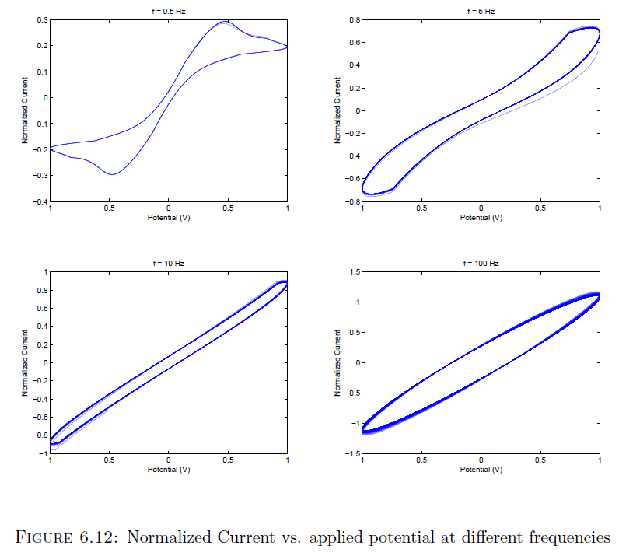
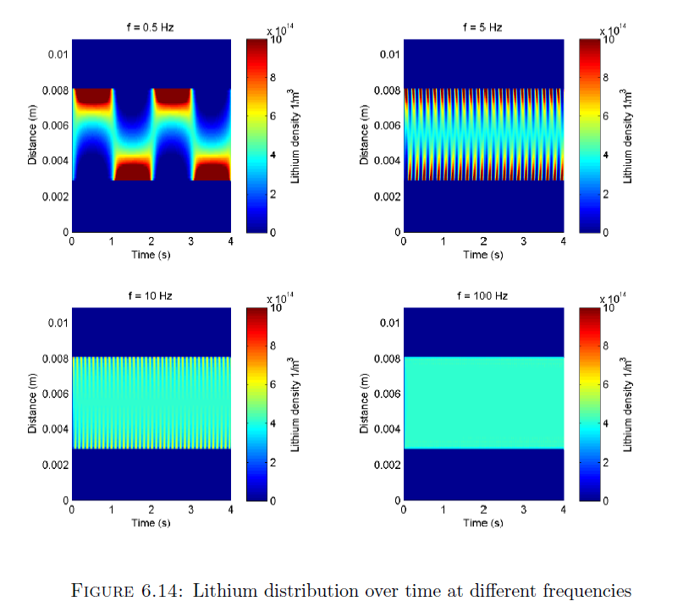
4.3- 2-D Memristor model cont.
Notes:
Sinusoid: Current Output, Lithium, perchlorate and hole density, Efield ?

Slide 20
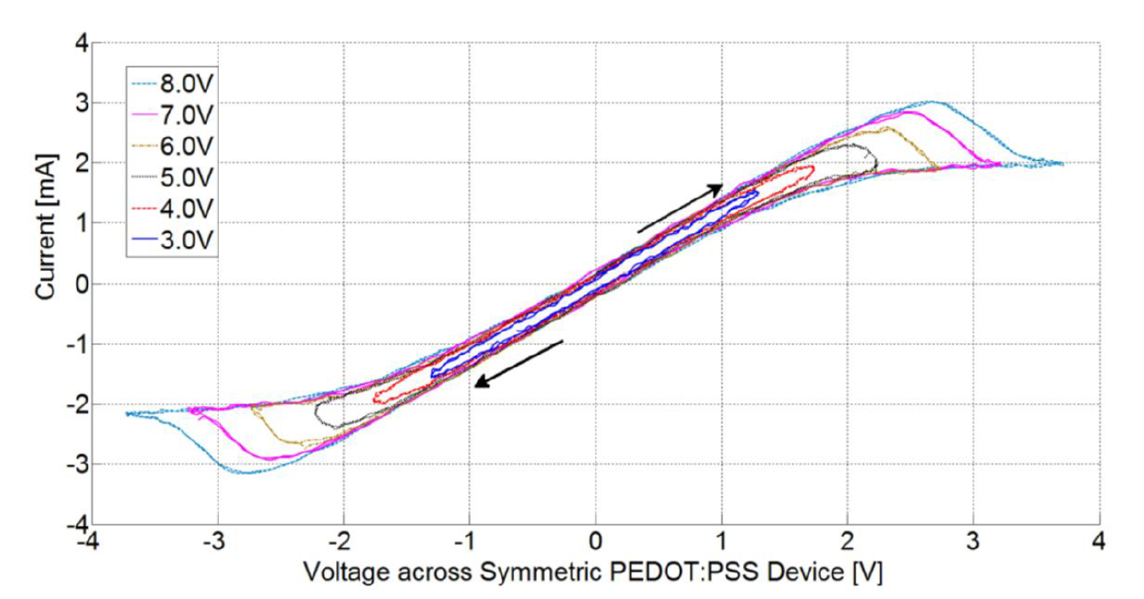
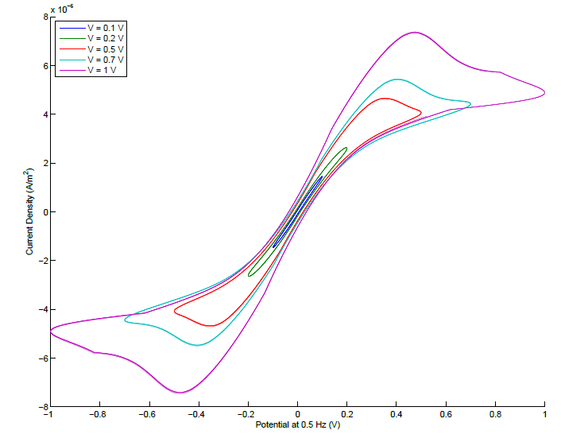
5. 2-D simulation vs. experimental results

Slide 21
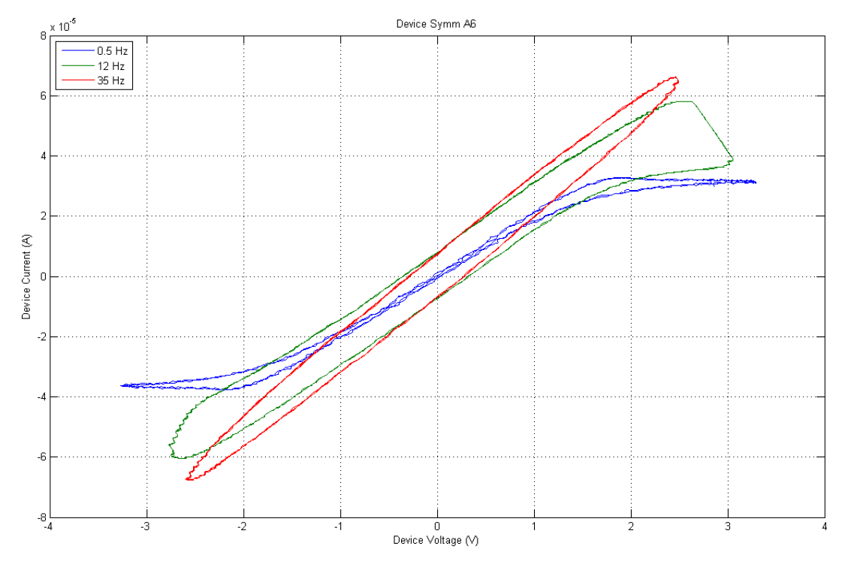
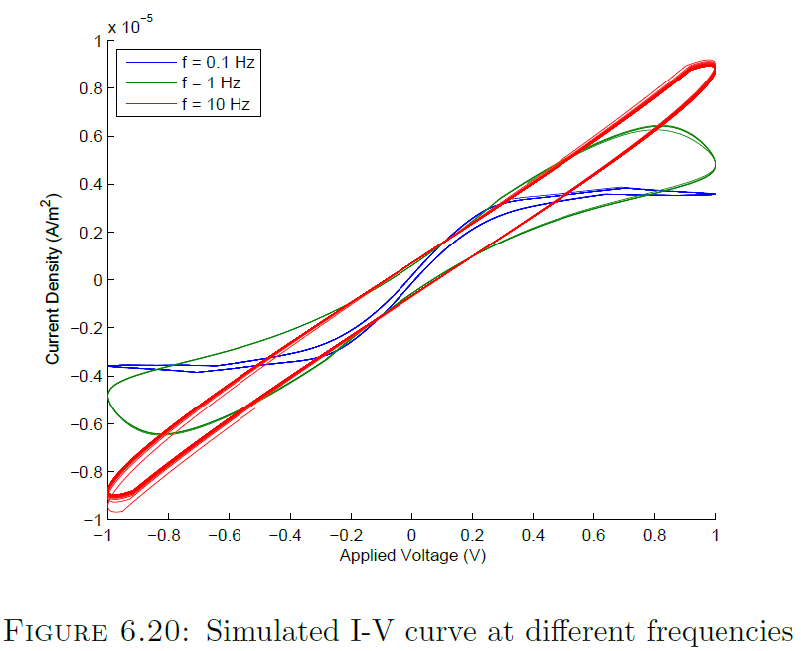
5. 2-D simulation vs. experimental results Cont.

Slide 22
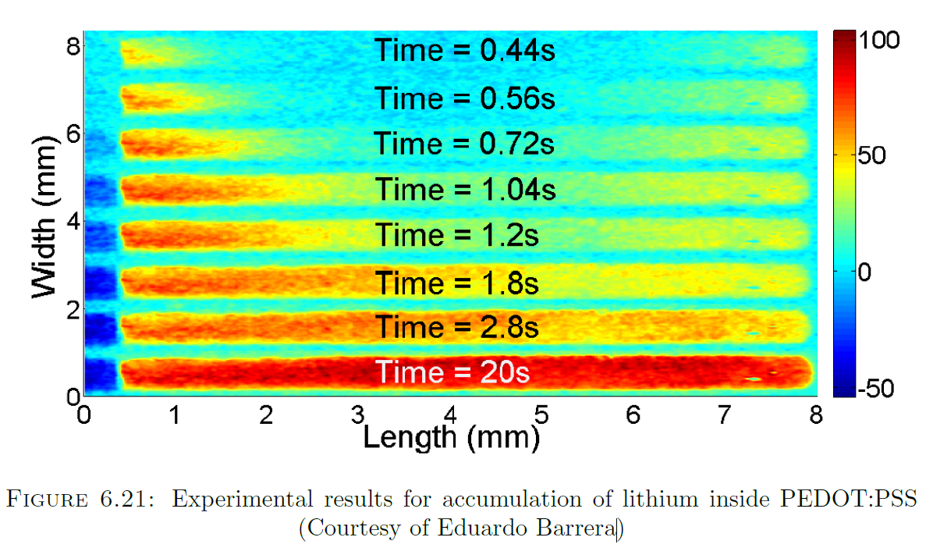
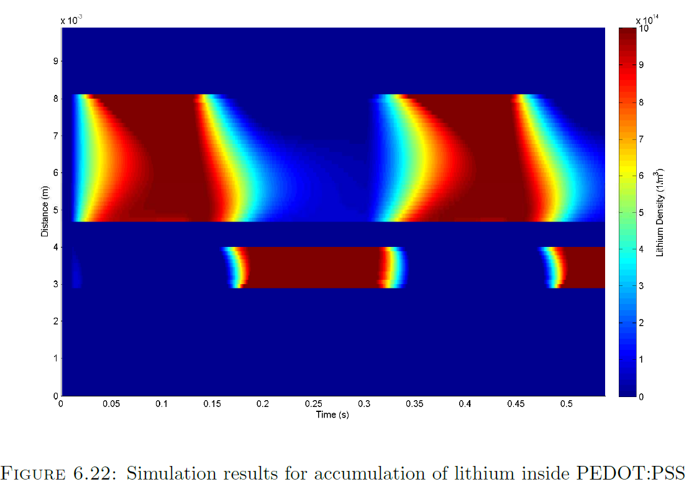
5. 2-D simulation vs. experimental results Cont.

Slide 23
6- Conclusion
Simulation of an organic memristor (Can be extended to other ionic devices)
Density Limiting Mechanism
Density scaling issues, parameter fitting
Additional modeling of hole transport mechanisms
Different Geometries
Further experimental verification
3D Modelling

Slide 24
